Slide 1
Conditions
Md. Khaliluzzaman
Dept. of CSE
IIUC

Slide 2
Remainder after division (modulo division %)
It is represented by %
Example: If we want to determine the result of 16 divide by 5, then we use the symbol ‘/’.
The operation is as:
16 / 5
result (Quotient)
5 | 16| 3
15
-------------
01
remainder
How can we determine it?
The problem can be solved by % operator

Slide 3
Remainder after division (modulo division %)
result = 16/5
5 | 16| 3
15
-------------
01
remainder = 16%5
float x, y, result;
int remainder;
x = 17; y = 3 ;
result = x / y;
remainder = x%y;
What is the value of result (Quotient) and remainder ?

Slide 4
Remainder after division (modulo division %)
How can you determine a value is divisible by 2 or not?
“A integer number which is divided by 2 and its remainder is 1 is odd number” – do you agree?

Slide 5
if condition
The syntax of the if statement in C programming is:
if (test expression)
{
// True block
// statements to be executed if the test expression is true
}
Any test condition/expression is evaluated in two form:
It is either True or False
If the test expression is evaluated to true, the True block statements will be executed

Slide 6
if …. else condition
The syntax of the if … else statement in C programming is:
True
if (test expression)
{
// True block
// statements to be executed
// if the test expression is true
}
else
{
// False block
// statements to be executed
//if the test expression is false
}
False
True
Test condition
False
True
Block
False
Block

Slide 7
if …. else condition
Determine from the a and b, which value is bigger.
if (test expression)
{
printf(“a is bigger.”);
}
True
if (a>b)
False
a is bigger
b is bigger.
else
{
printf(“b is bigger.”);
}

Slide 8
Nested if …. else condition
It is possible to include an if...else statement inside the body of another if...else statement.
Here, second condition depend on the top conditions.
Test cond-1
True
False
Test cond-2
Test cond-3
False
True
True
True block-1
False block
True block-2

Slide 9
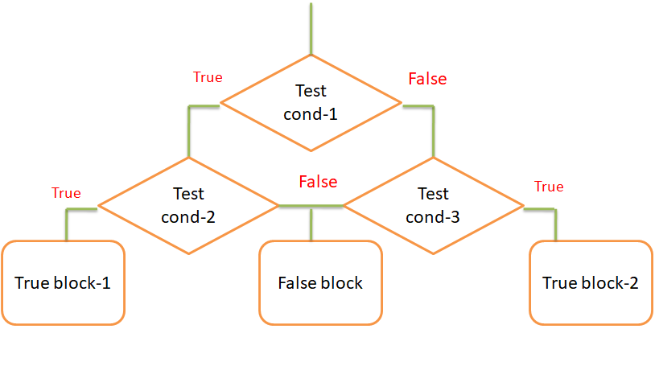
Nested if …. else condition
if (test cond-1)
{
if (test cond-2)
{
// True block1
}
else
{
// False block
}
}
else
{
if (test cond-3)
{
// True block2
}
else
{
// False block
}
}

Slide 10
Nested if …. else condition
Find the largest number among three numbers.
If (a>b)
True
False
if (a>c)
if (b >c)
False
True
True
a is largest.
c is largest.
b is largest.

Slide 11
if...else Ladder
The if...else statement executes two different codes depending upon whether the test expression is true or false. Sometimes, a choice has to be made from more than 2 possibilities.
The possibilities are independent to each other.
That means the conditions are independent for a specific task.

Slide 12
if...else Ladder
True
if (test expression-1)
{
// True statement-1
}
else if(test expression-2)
{
// True statement-2
}
. .
else
{
// else statement
}
Test expr-1
True
False
b is largest.
False
True
Test expr-2
True
b is largest.
False
False
……….
False
b is largest.

Slide 13
if...else Ladder
Write a C program to input marks of five subjects Physics, Chemistry, Biology, Mathematics and Computer. Calculate percentage and
grade according to following:
Percentage >= 90% : Grade A
Percentage >= 80% : Grade B
Percentage >= 70% : Grade C
Percentage >= 60% : Grade D
Percentage >= 40% : Grade E
Percentage < 40% : Grade F

